Slide 1

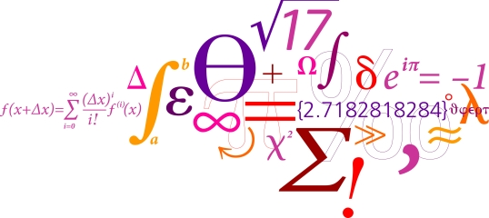

A DEEP LEARNING APPROACH TO CLASSIFYING, LOCATING AND SEPARATING
DIFFERENT SIZED WRENCHES FOR MBZIRC 2017
02456 Deep Learning
Servet Coskun, MSc EE
Bjarke Vad Pedersen, MSc EE
Jesper H. Christensen, MSc EE

Slide 2
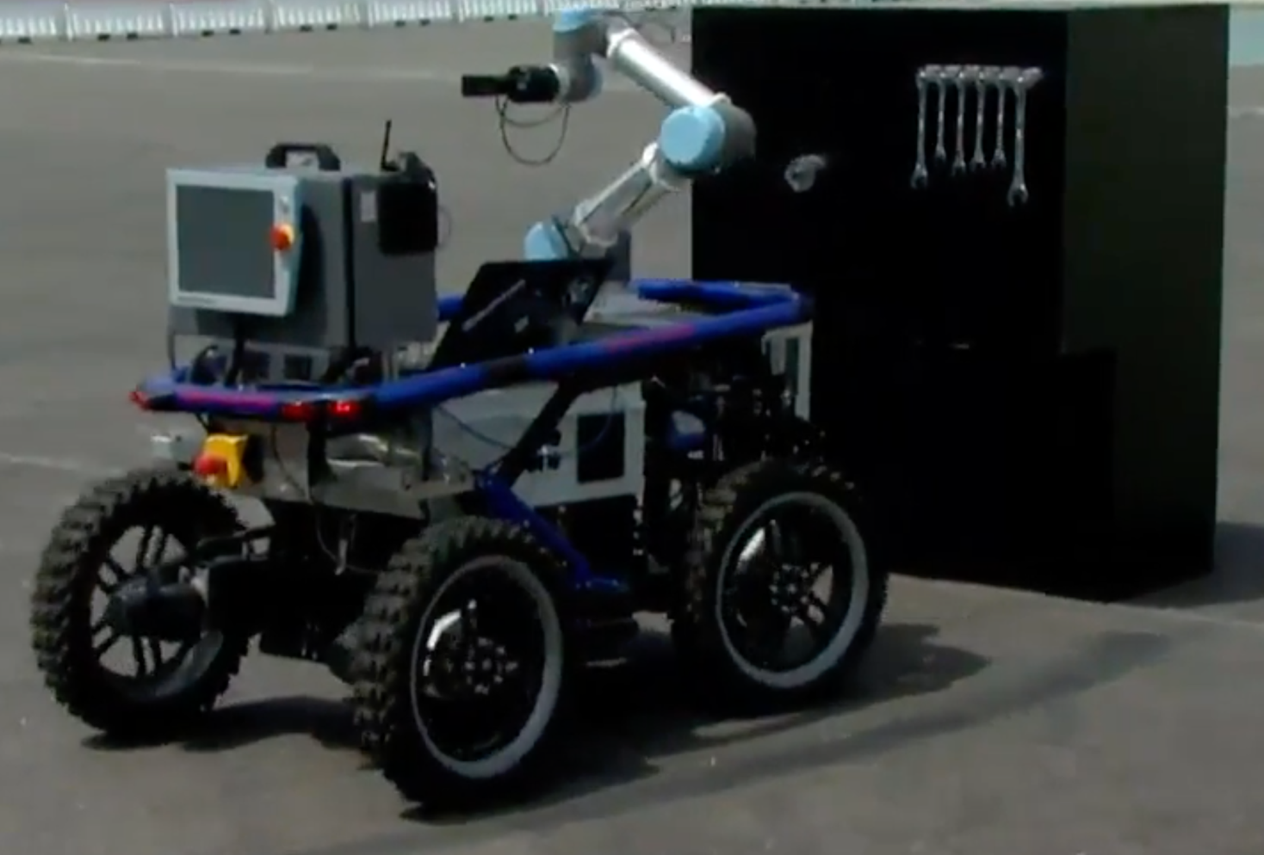
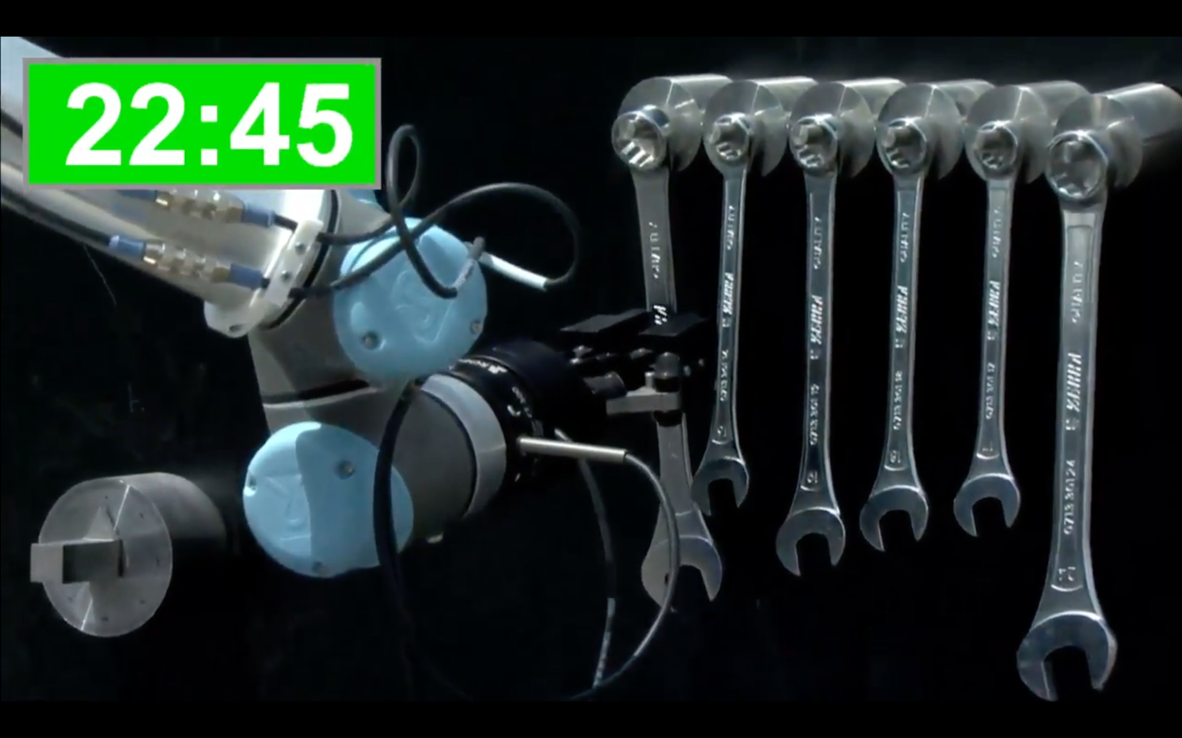
Introduction
MBZIRC 2017
Force feedback on gripper
Location of specific wrench
We present a deep learning approach!
Notes:
SERVET
- Explain task, 6 wrenches, locate one
- 1:30 min

Slide 3
Overview
Data Acquisition
Image Classification Approach
Methodology
CNN
Transfer Learning
Challenges
Sub-Conclusion
Object Detection Approach
Methodology
Faster R-CNN
Post-Processing
Results
Future Work
Notes:
SERVET

Slide 4
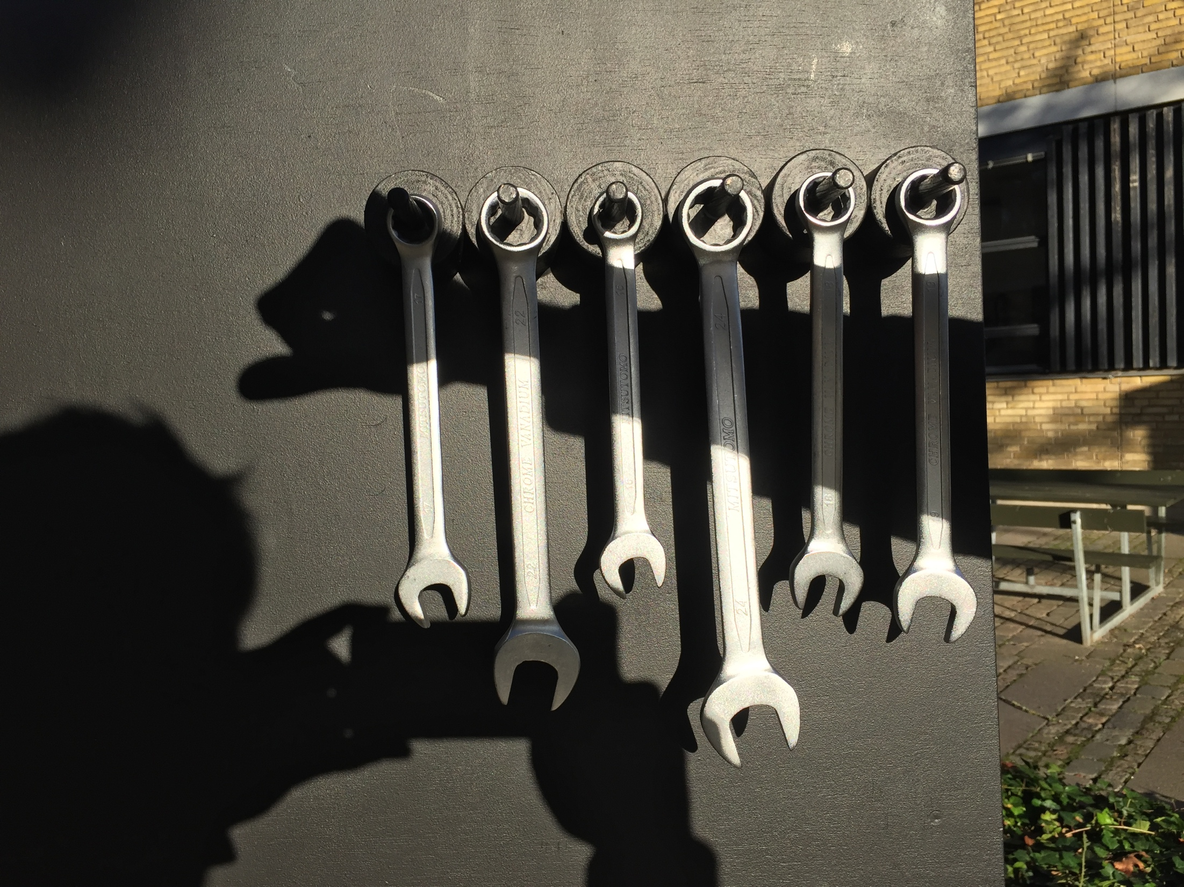
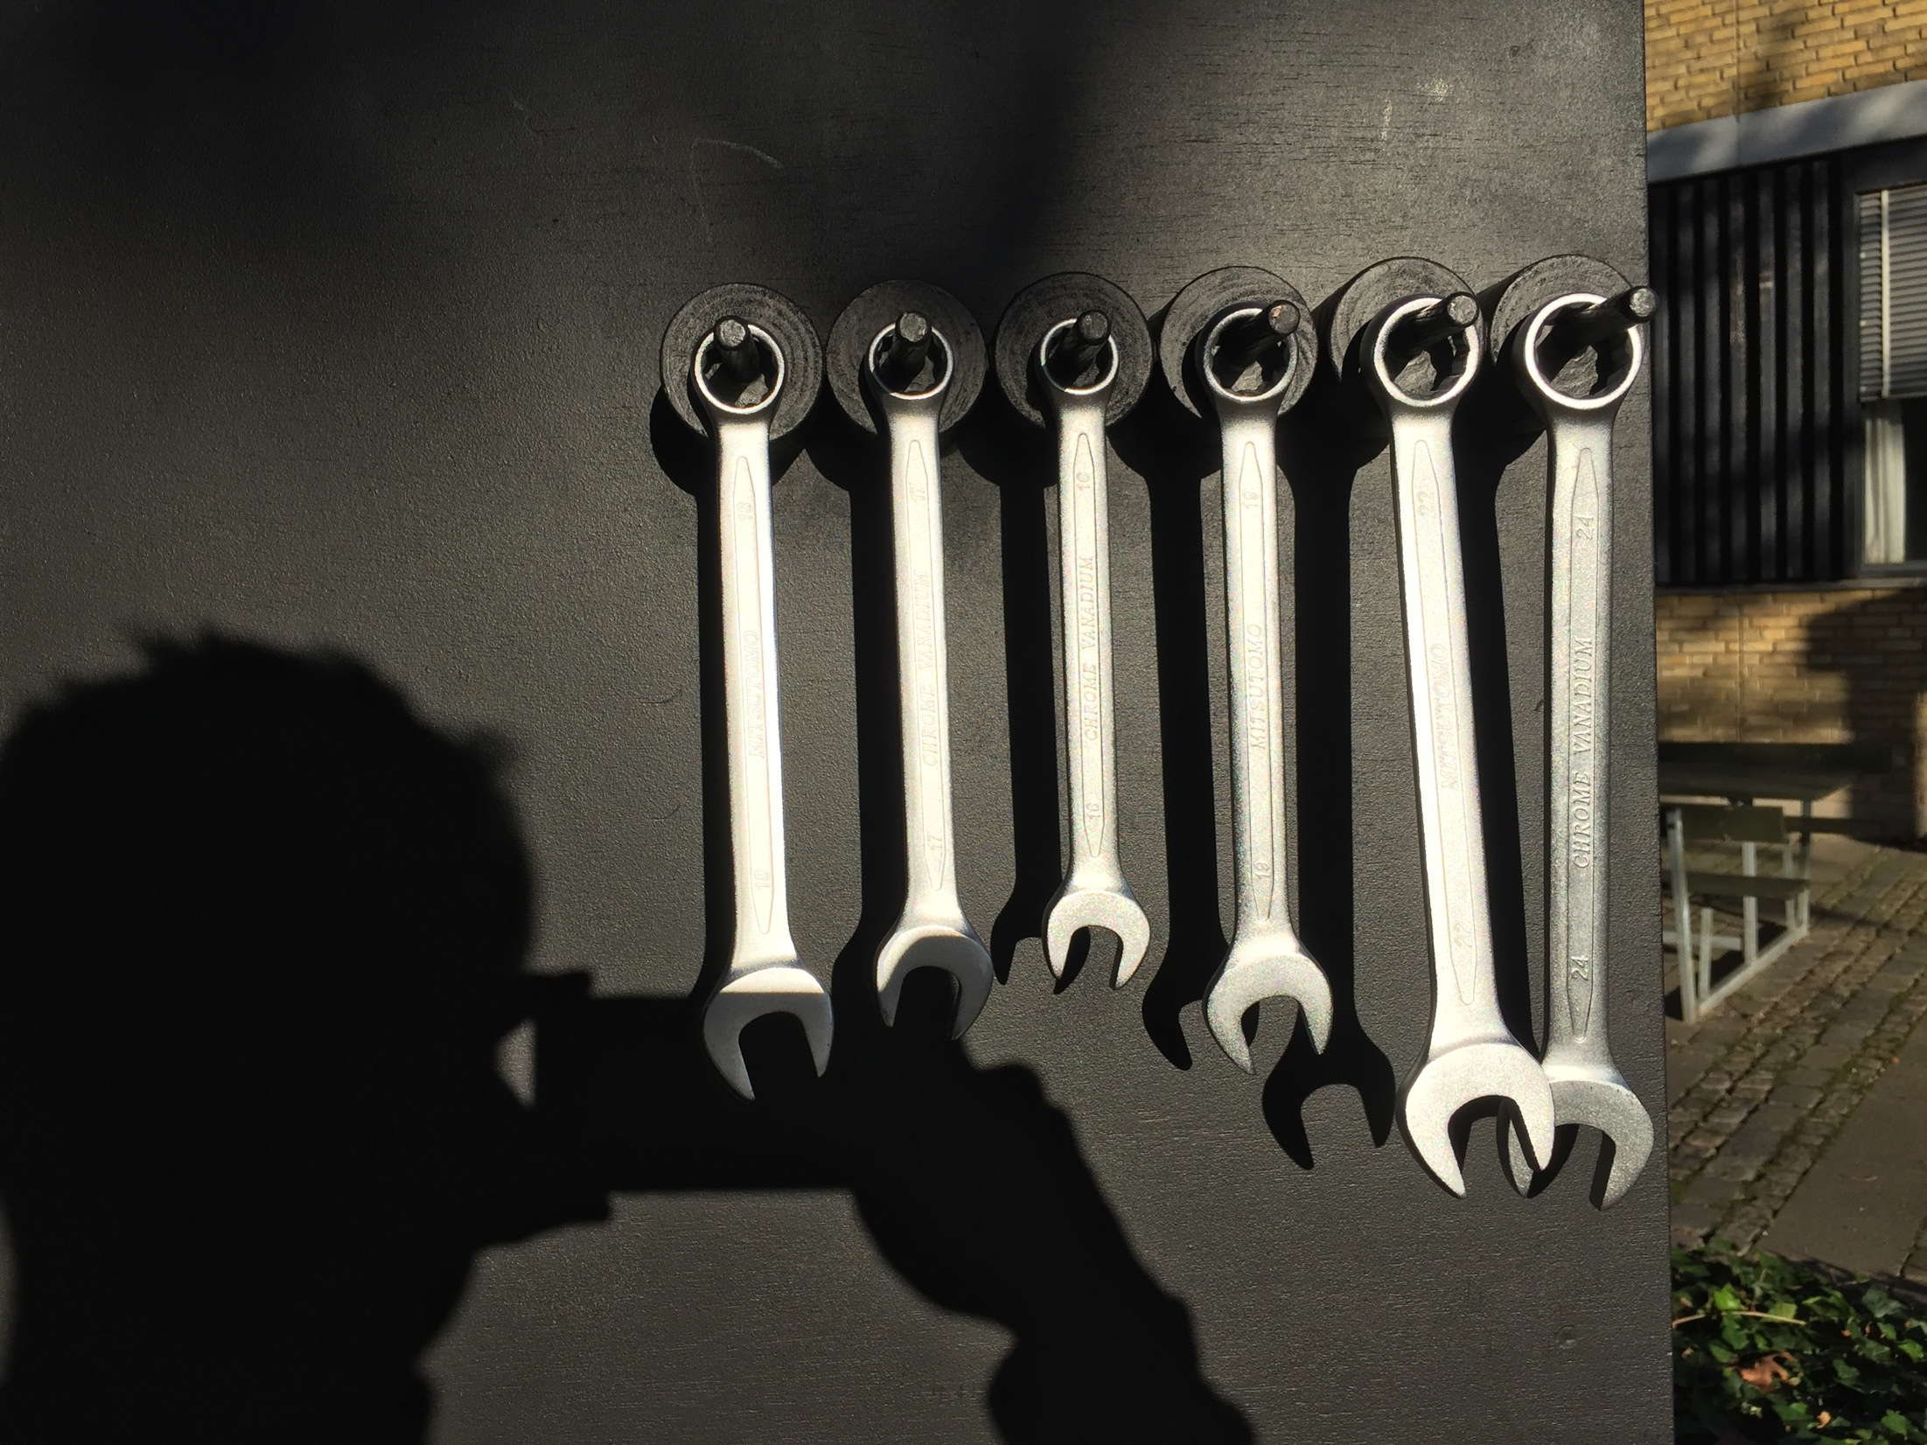
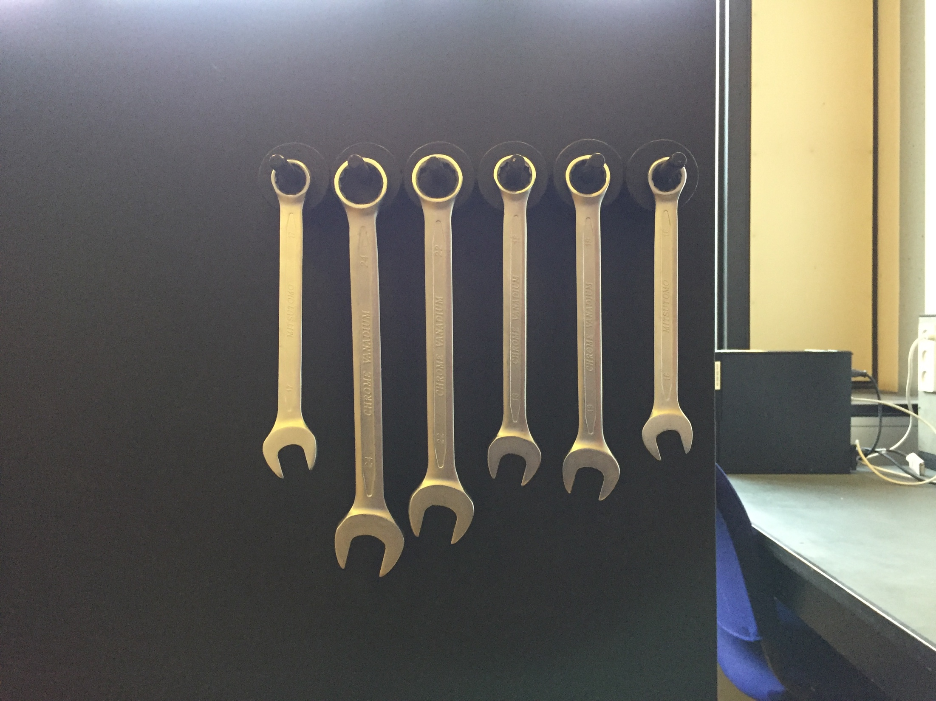
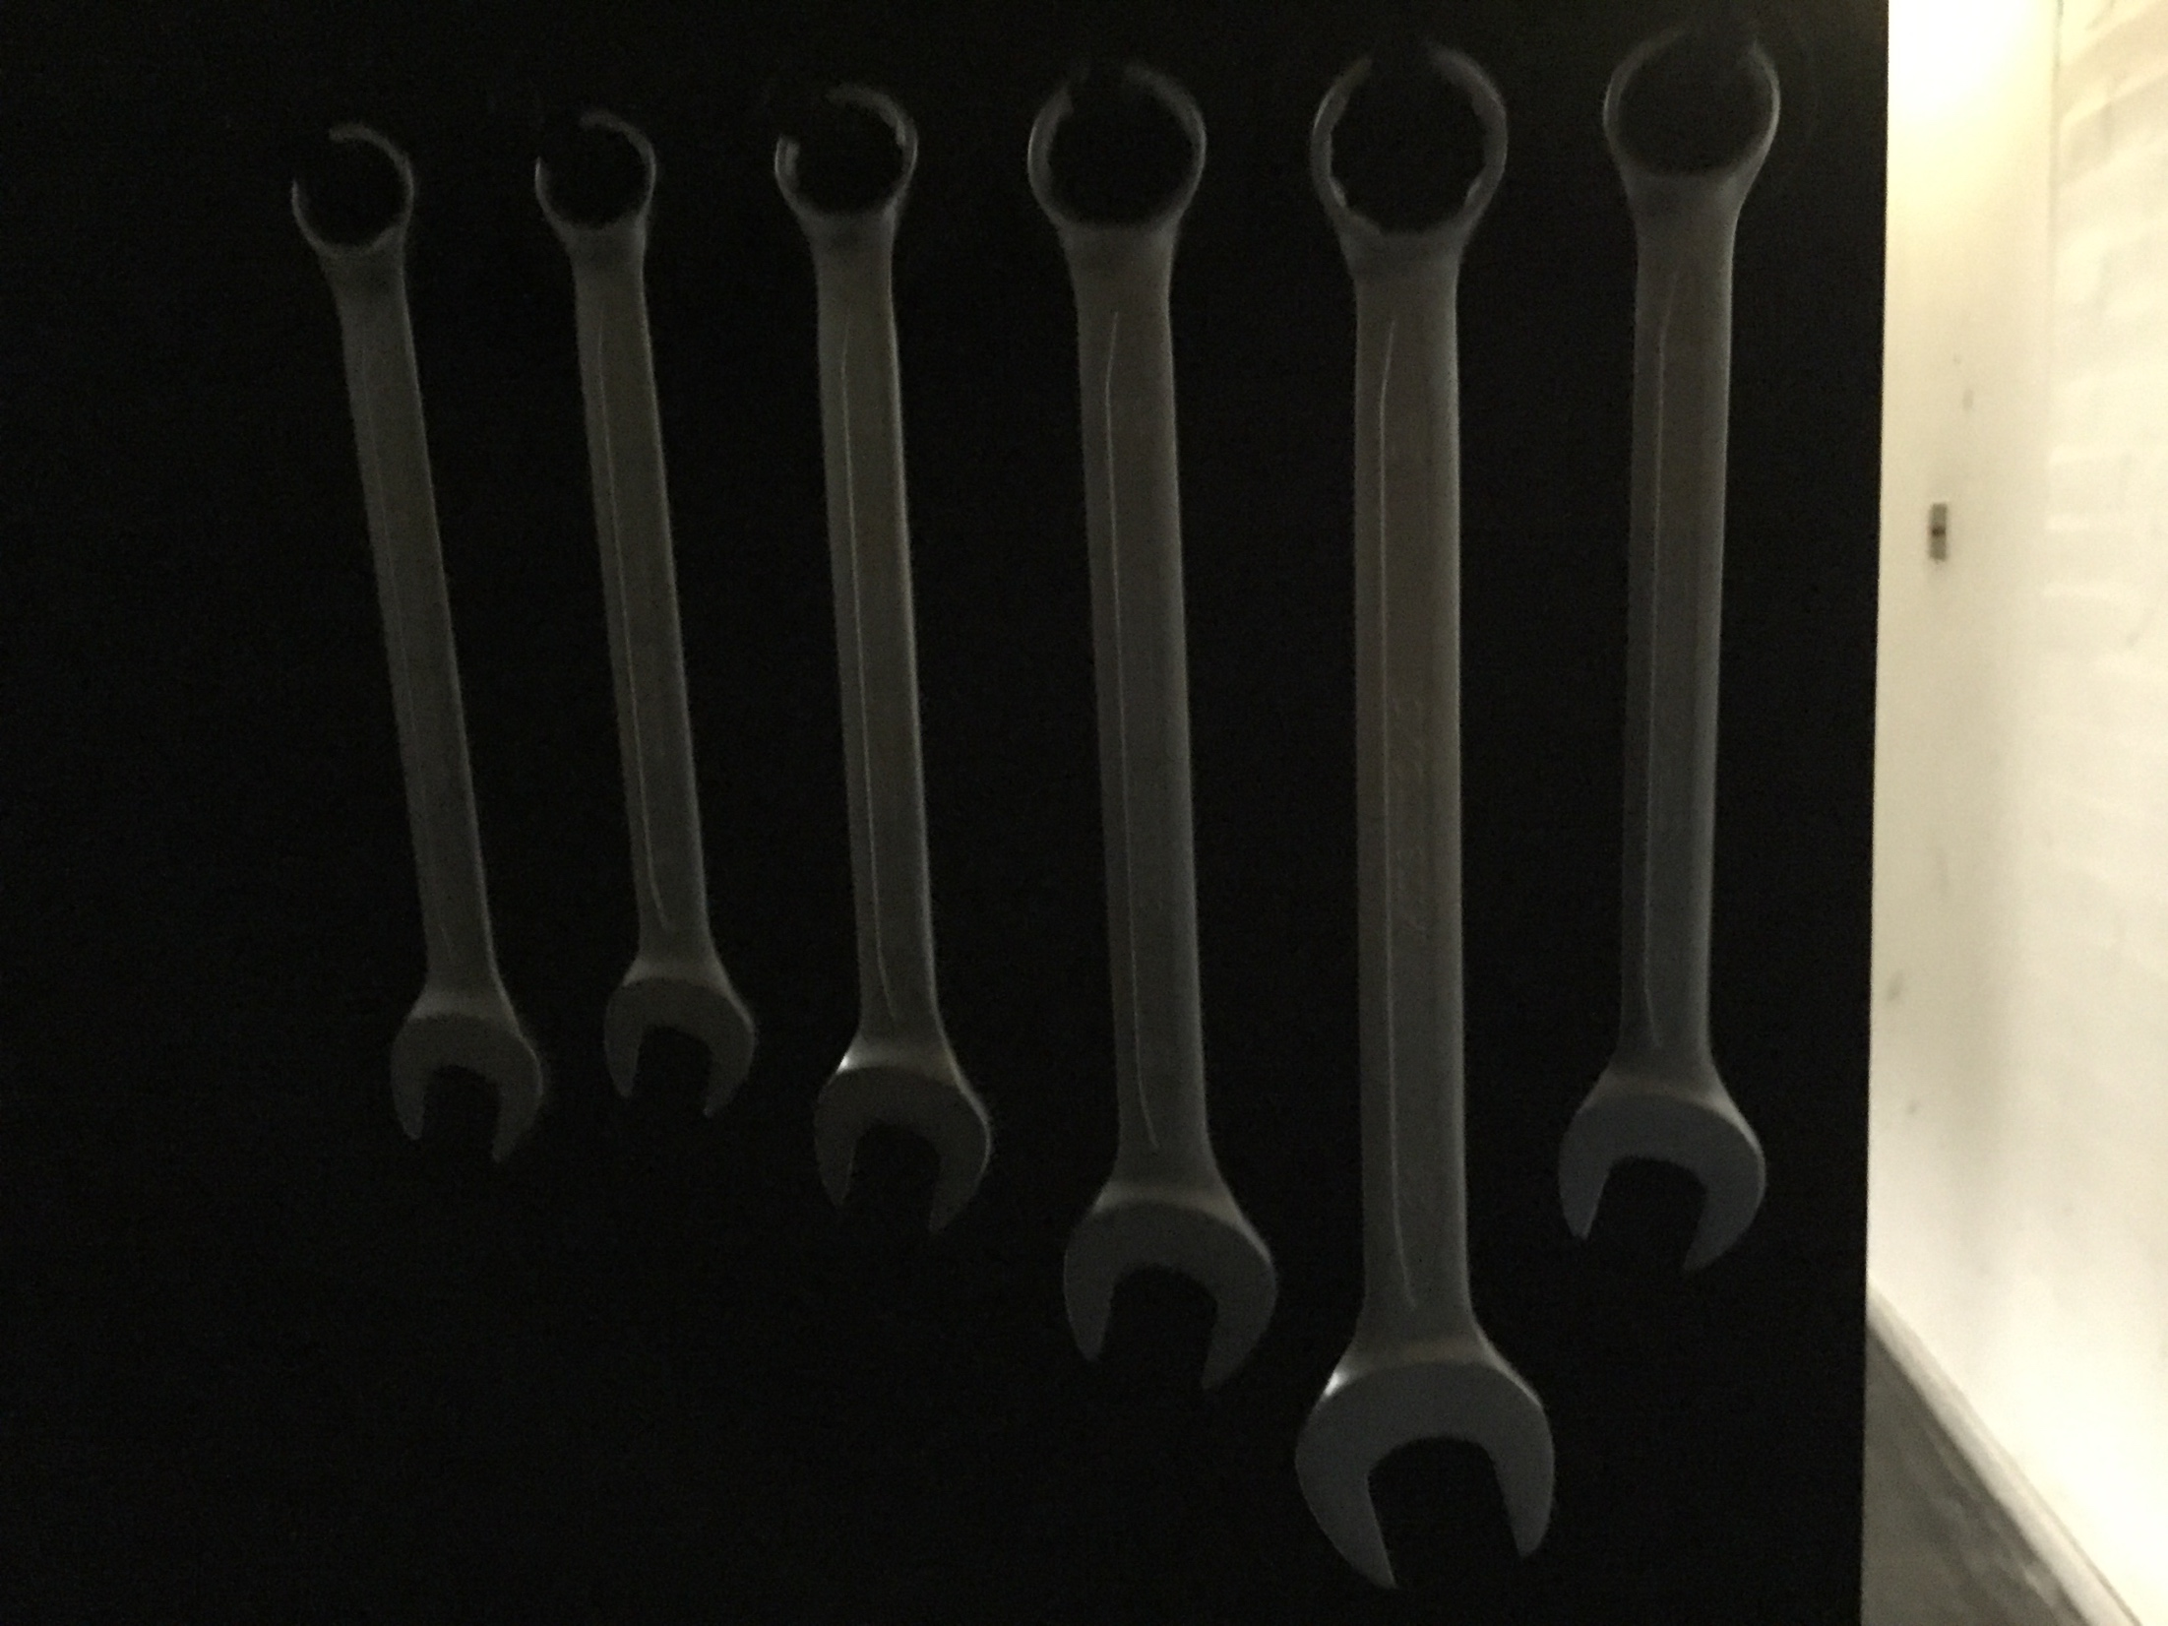
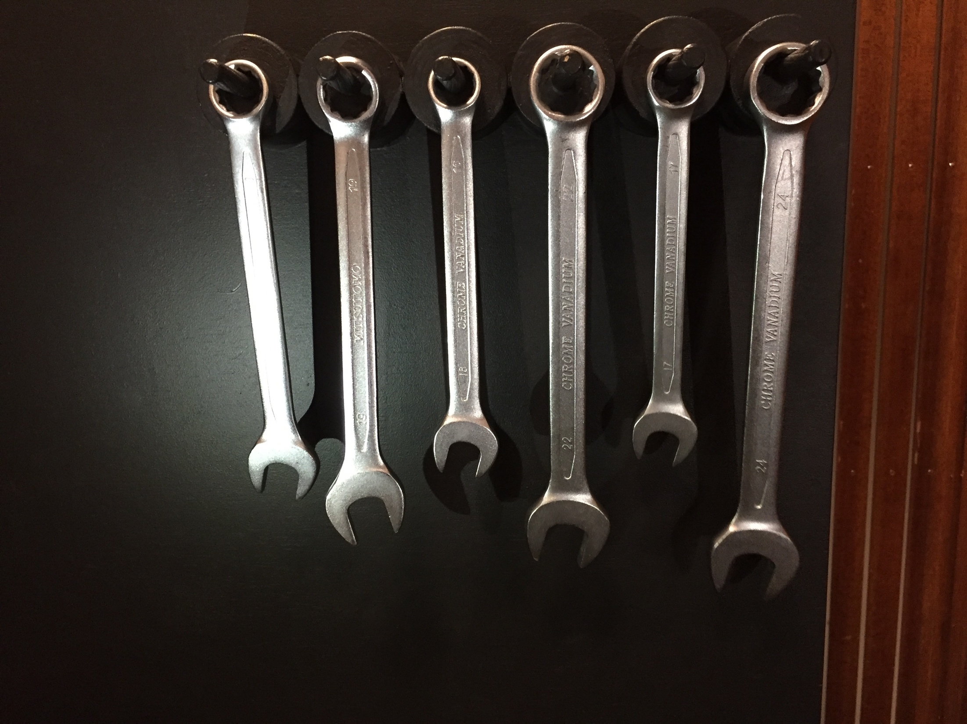
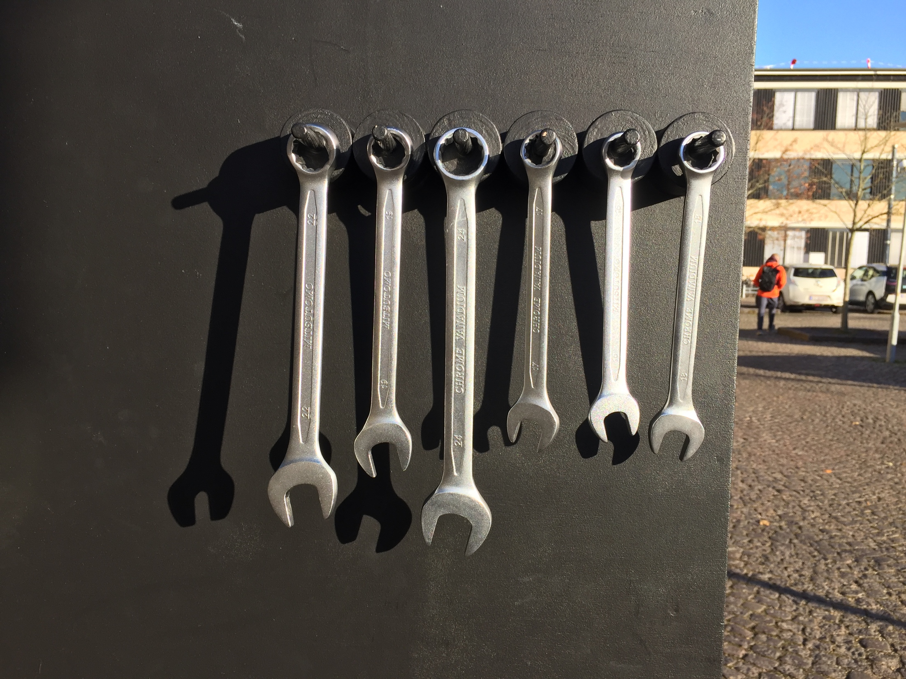
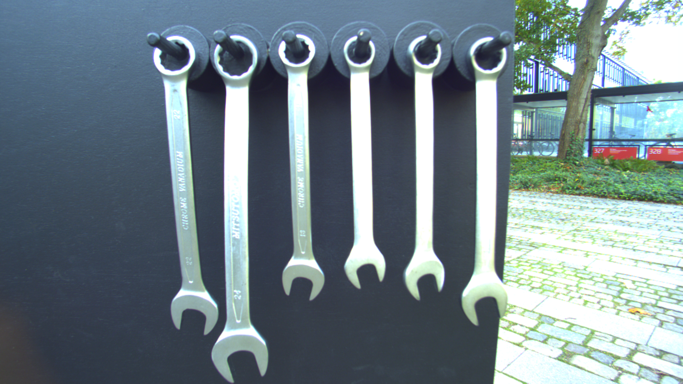
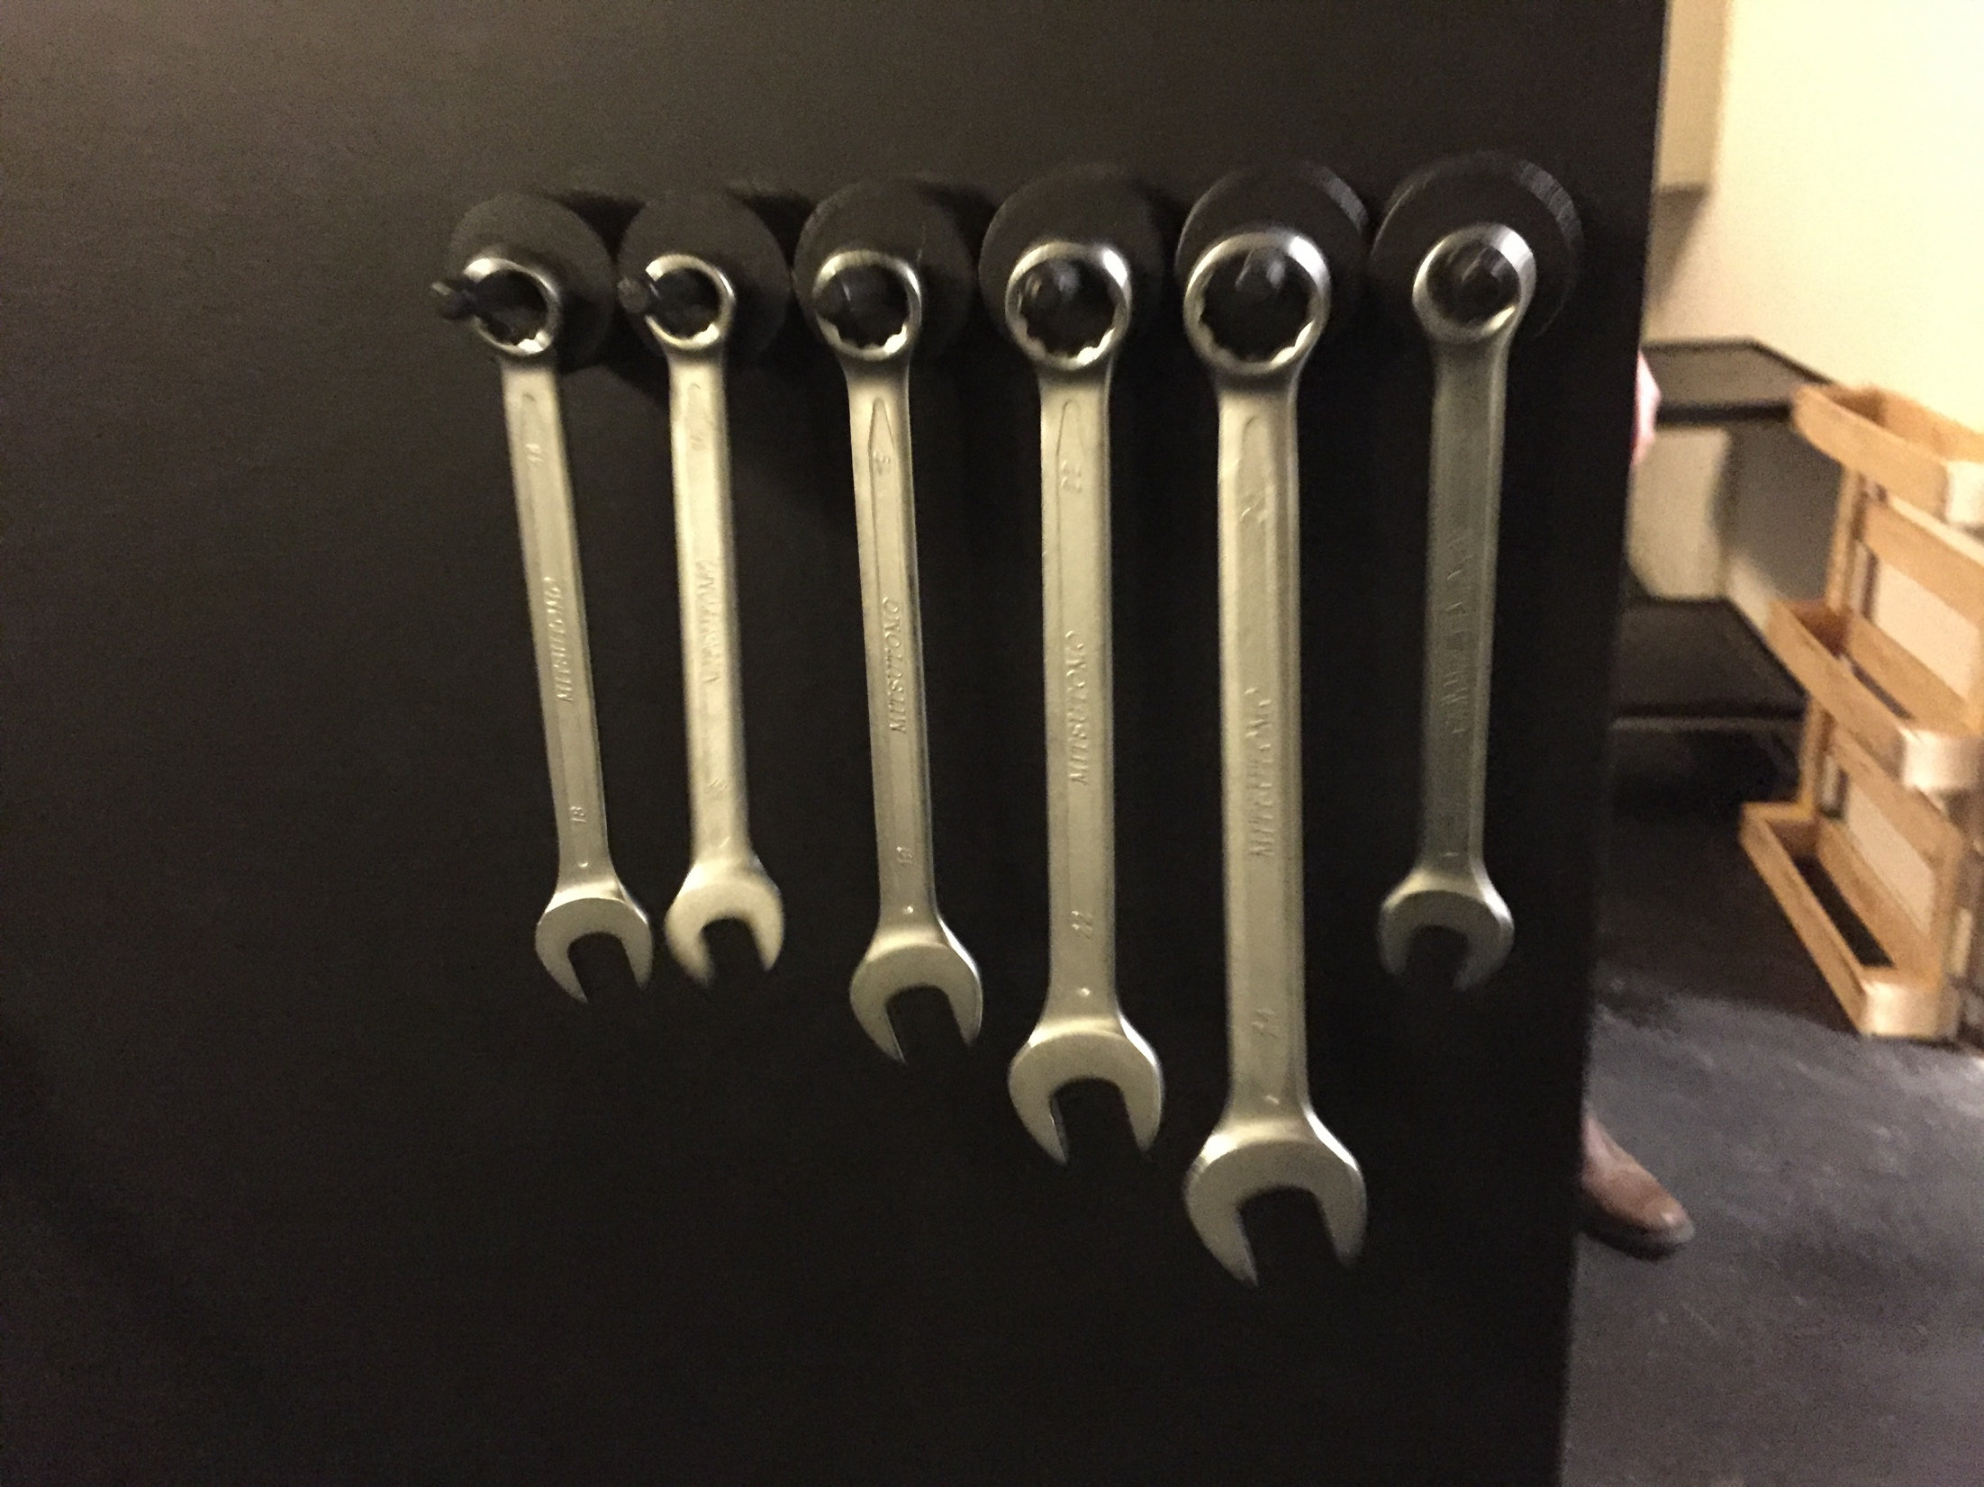
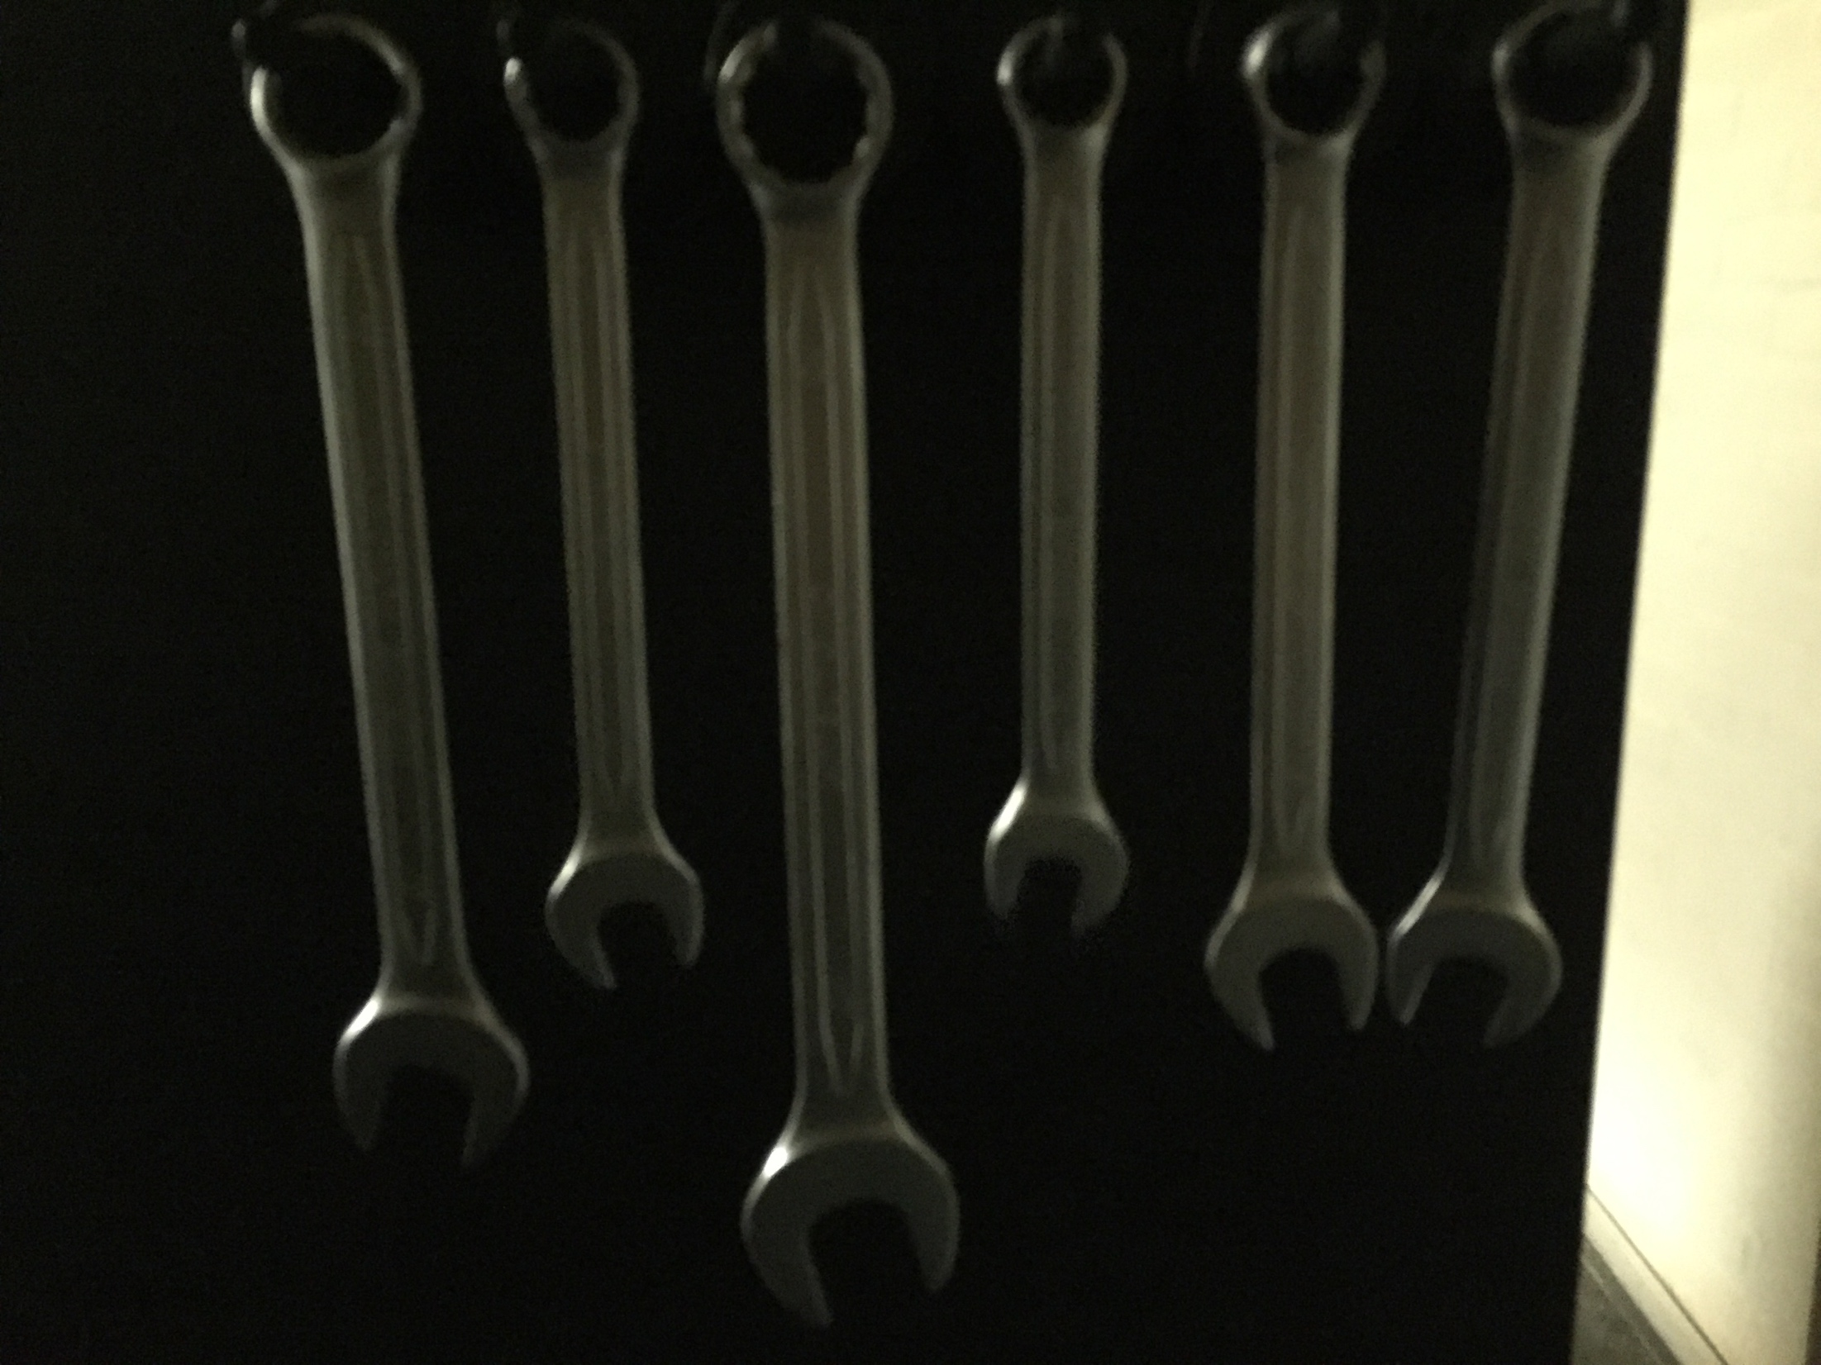
Data Acquisition
Acquired over several days
Varying background
Weather, lighting, shadows
Rotation, skew, distance
~500 unique images
Notes:
SERVET

Slide 5
Classification
Tries to predict the position of wrench 19, e.g. [0,0,1,0,0,0]
Images is labelled accordingly to position, e.g. 17_18_22_16_19_24.png
Initial approach based on standard CNN approach and transfer learning
Notes:
BJARKE

Slide 6
CNN Architecture
6 softmax outputs, dropout, pooling, regularization, batch-norm
Heavy image augmentation, image pre-processing
Notes:
BJARKE
Image classification approach
Pre processing and image augmentaion
Limit pooling to preserve vital spatial dependencies of how wrenches are of independant sizes.

Slide 7
Transfer Learning
Based on state of the art models trained on image-net
Fine-tuning to the wrench dataset
VGG16 [1], InceptionV3 [2] ,
Xception [3]
Figure credit: https://blog.heuritech.com/2016/02/29/
a-brief-report-of-the-heuritech-deep-learning-meetup-5/
[1] - https://arxiv.org/pdf/1409.1556.pdf
[2] - https://arxiv.org/pdf/1512.00567.pdf
[3] - https://arxiv.org/pdf/1610.02357.pdf
Notes:
JESPER
Image classification approach

Slide 8
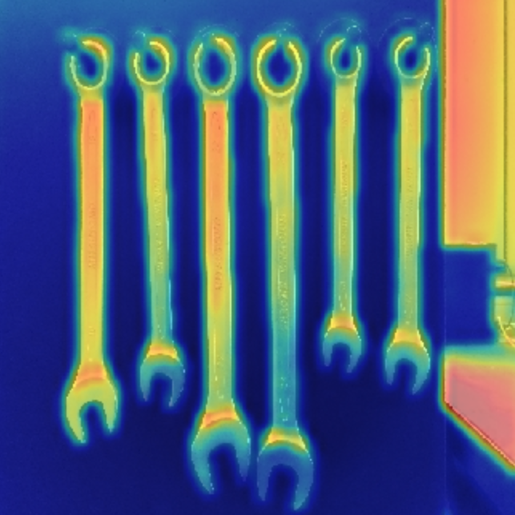
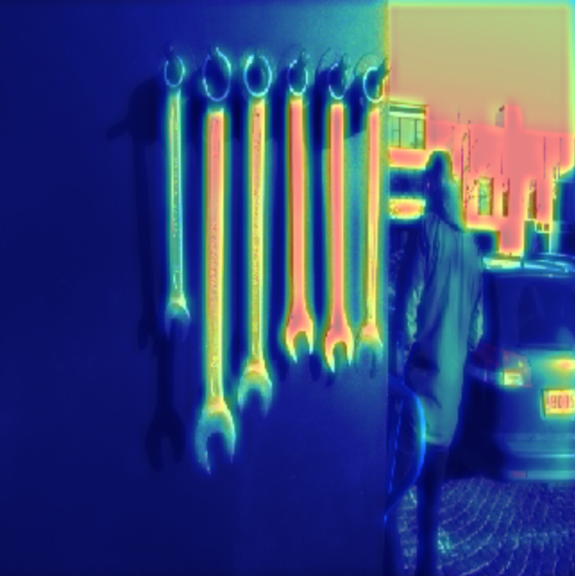
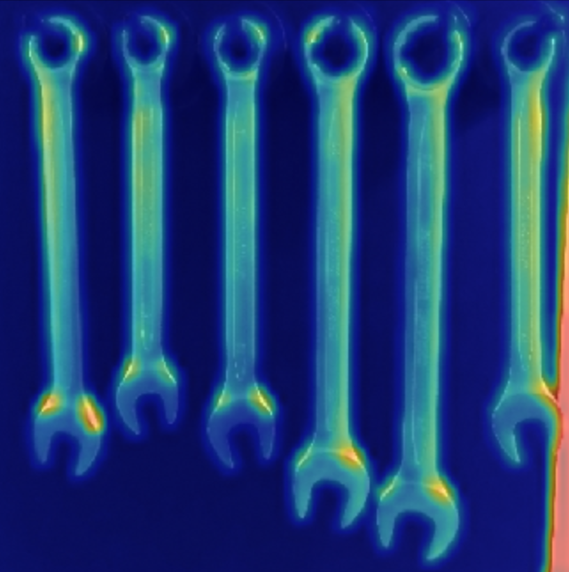
Challenges
Overfitting, background encoding
Attention maps [4] → image cropping
[4] - https://github.com/raghakot/keras-vis
Notes:
SERVET
Image classification approach
- both models worked on train but failed on test
- we want to see why therefore Attention maps
- Encoding background
- = Overfitting
- then we tried to crop to only show wrenches

Slide 9
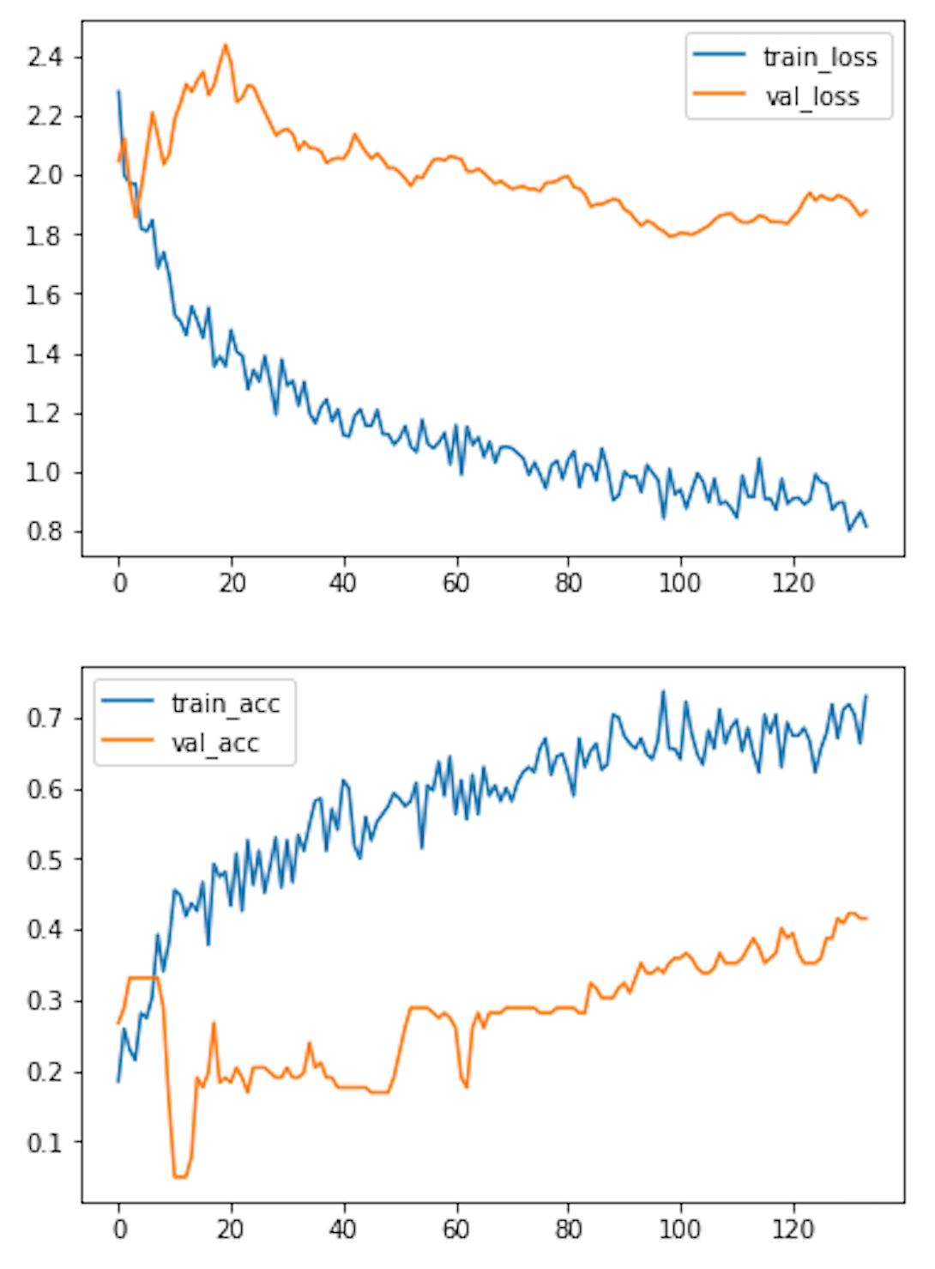
Sub-Conclusion
Reduced overfitting by cropping
Validation accuracy no more than 40%
Classification CNN could not learn to separate same objects by size!
….
What to do?
Notes:
BJARKE
Image classification approach

Slide 10
Object Detection
Find objects in the image
Scale and rotational invariance
Region of interest
Opening and eye of wrench (top & bot)
State-of-the-art object detection
Image credit: https://arxiv.org/pdf/1506.01497.pdf
Notes:
JESPER

Slide 11
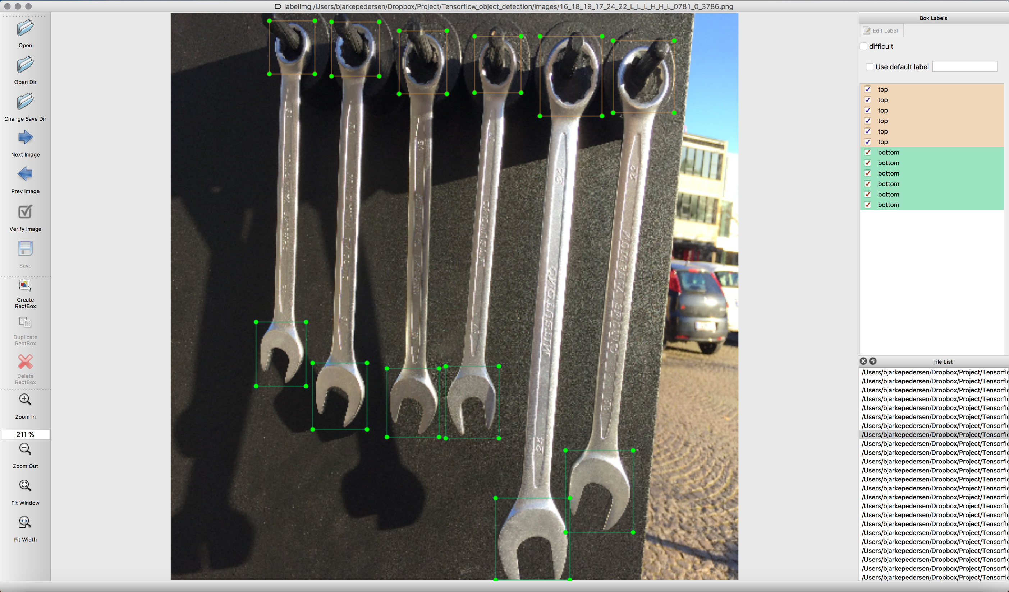
Github LabelImg: https://github.com/tzutalin/labelImg
Labelling
Notes:
JESPER

Slide 12
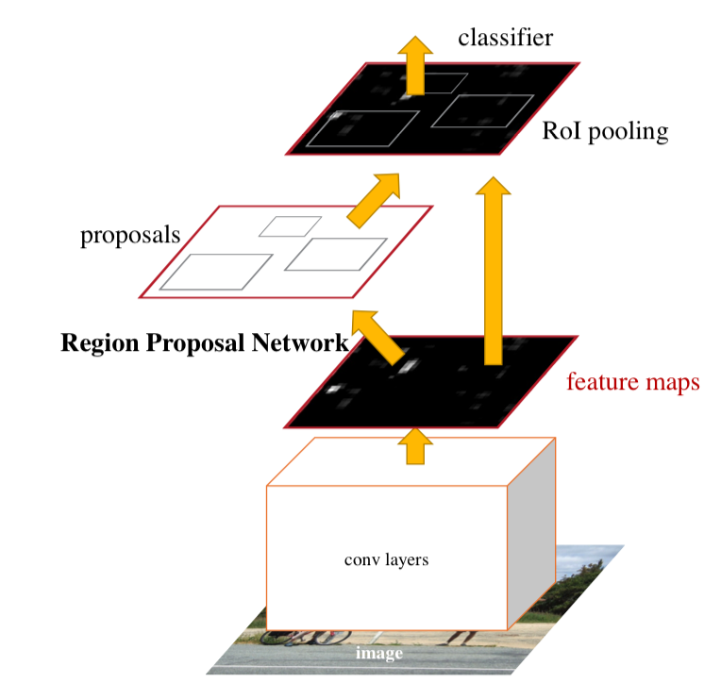
Methodology
Transfer learning a variation of Faster R-CNN [5]
CNN-block architecture Inception-ResNet [6] trained on Image-net
Complete model fine-tuned to MS COCO [7]
[5]
[5] - https://arxiv.org/pdf/1506.01497.pdf
[6] - https://arxiv.org/pdf/1602.07261.pdf
[7] - https://arxiv.org/pdf/1405.0312.pdf
Notes:
Jesper

Slide 13
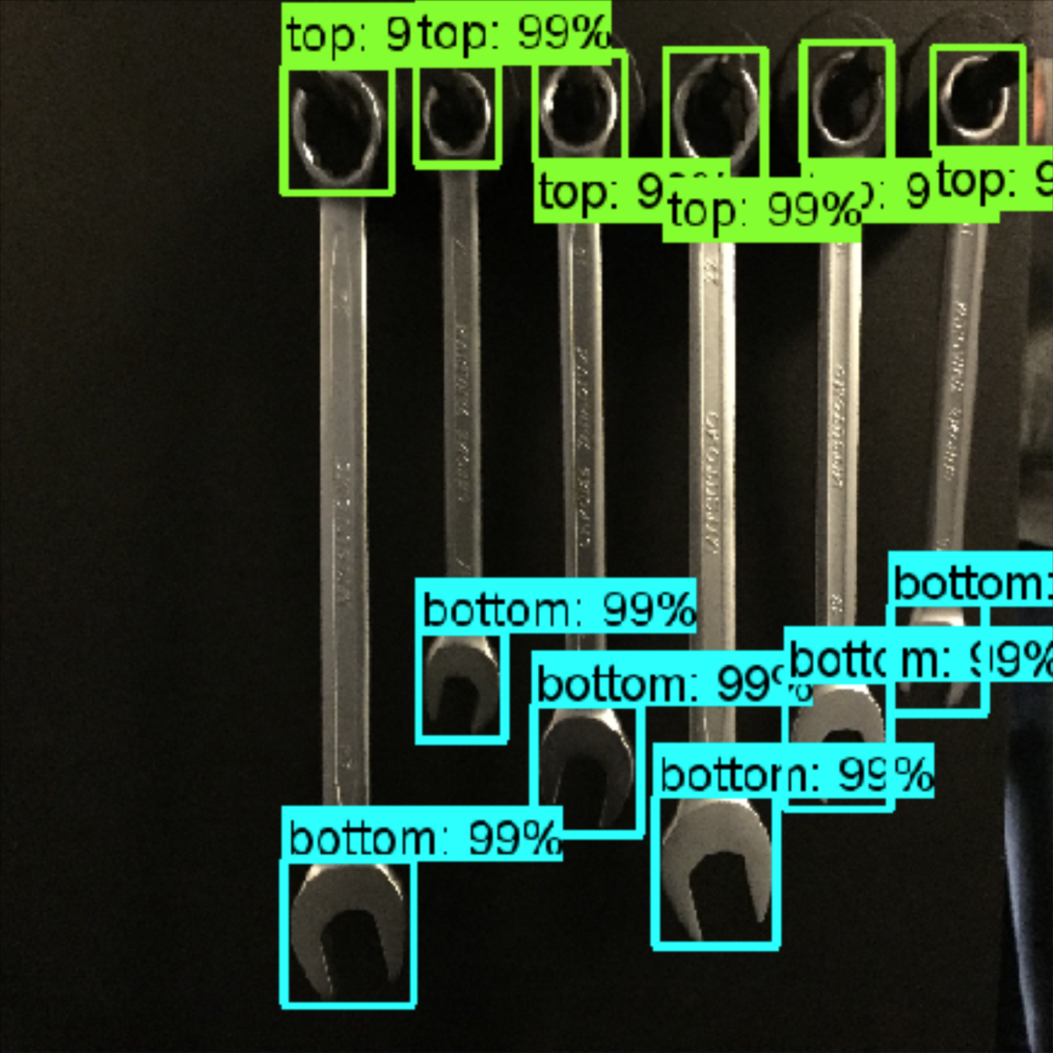
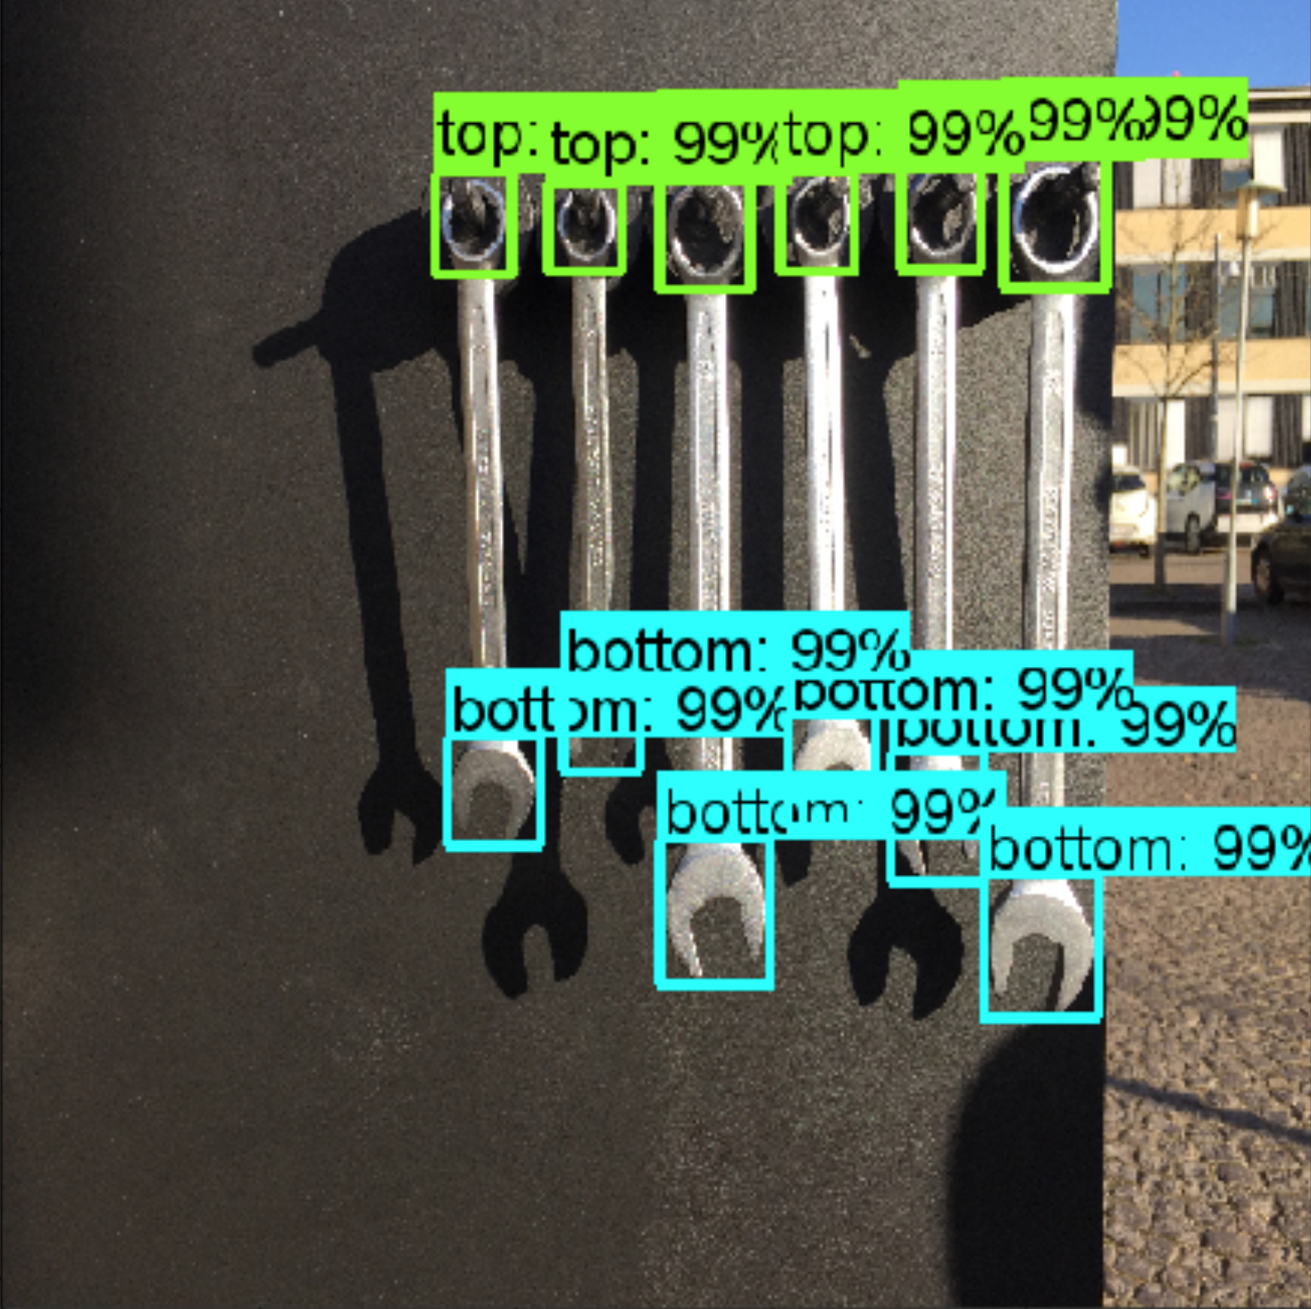
Object Detection
Notes:
BJARKE
Skarp bounding box

Slide 14
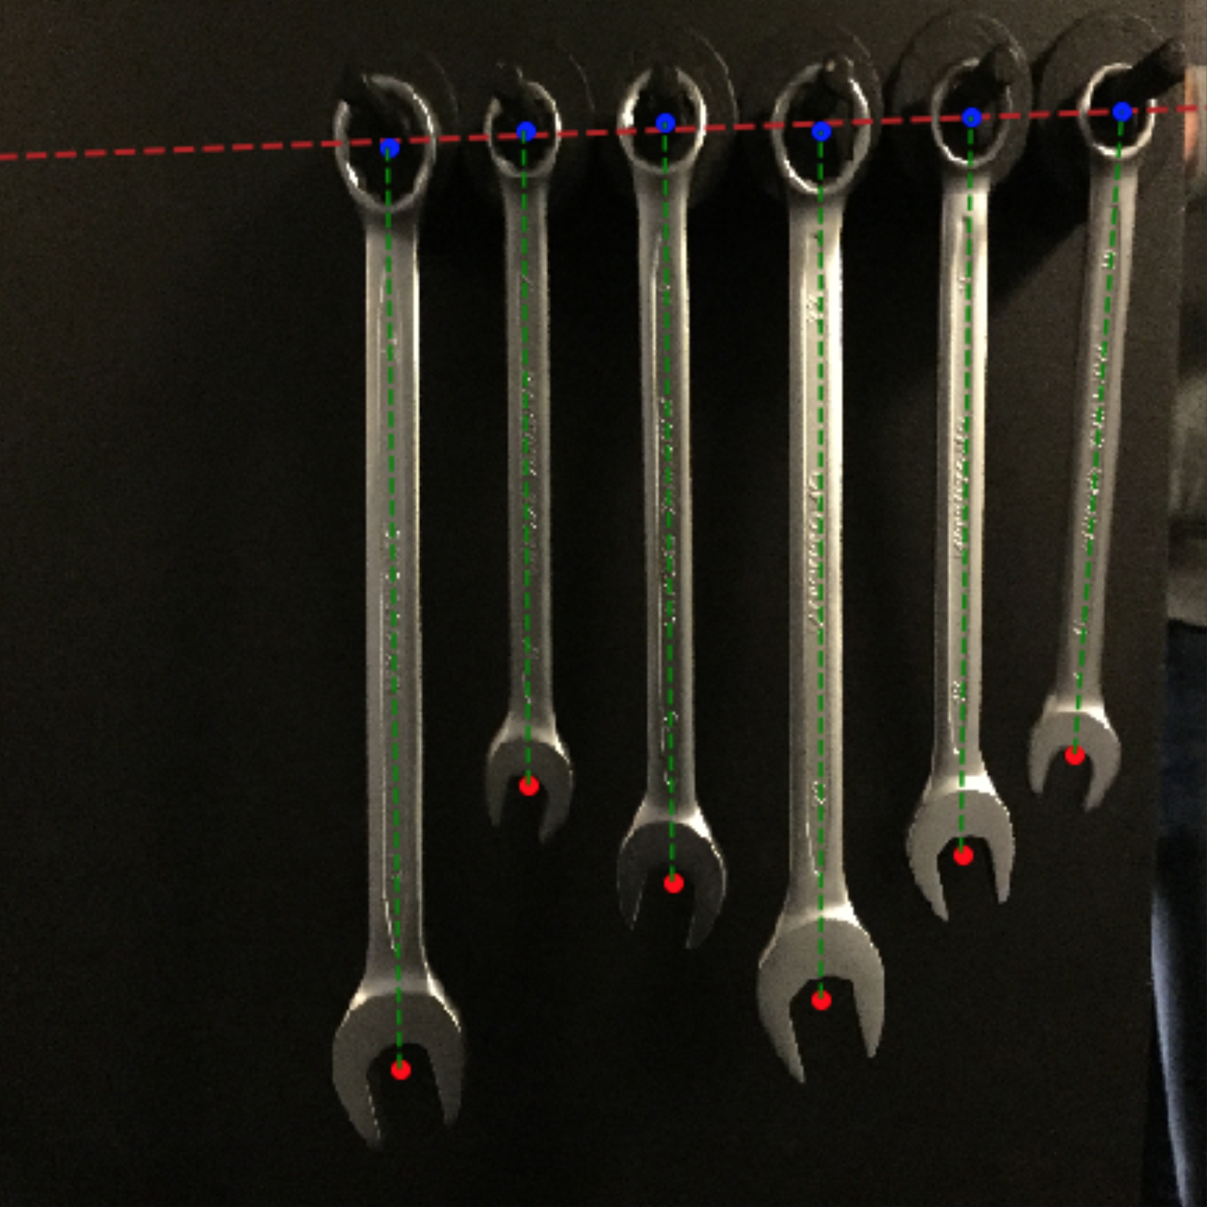
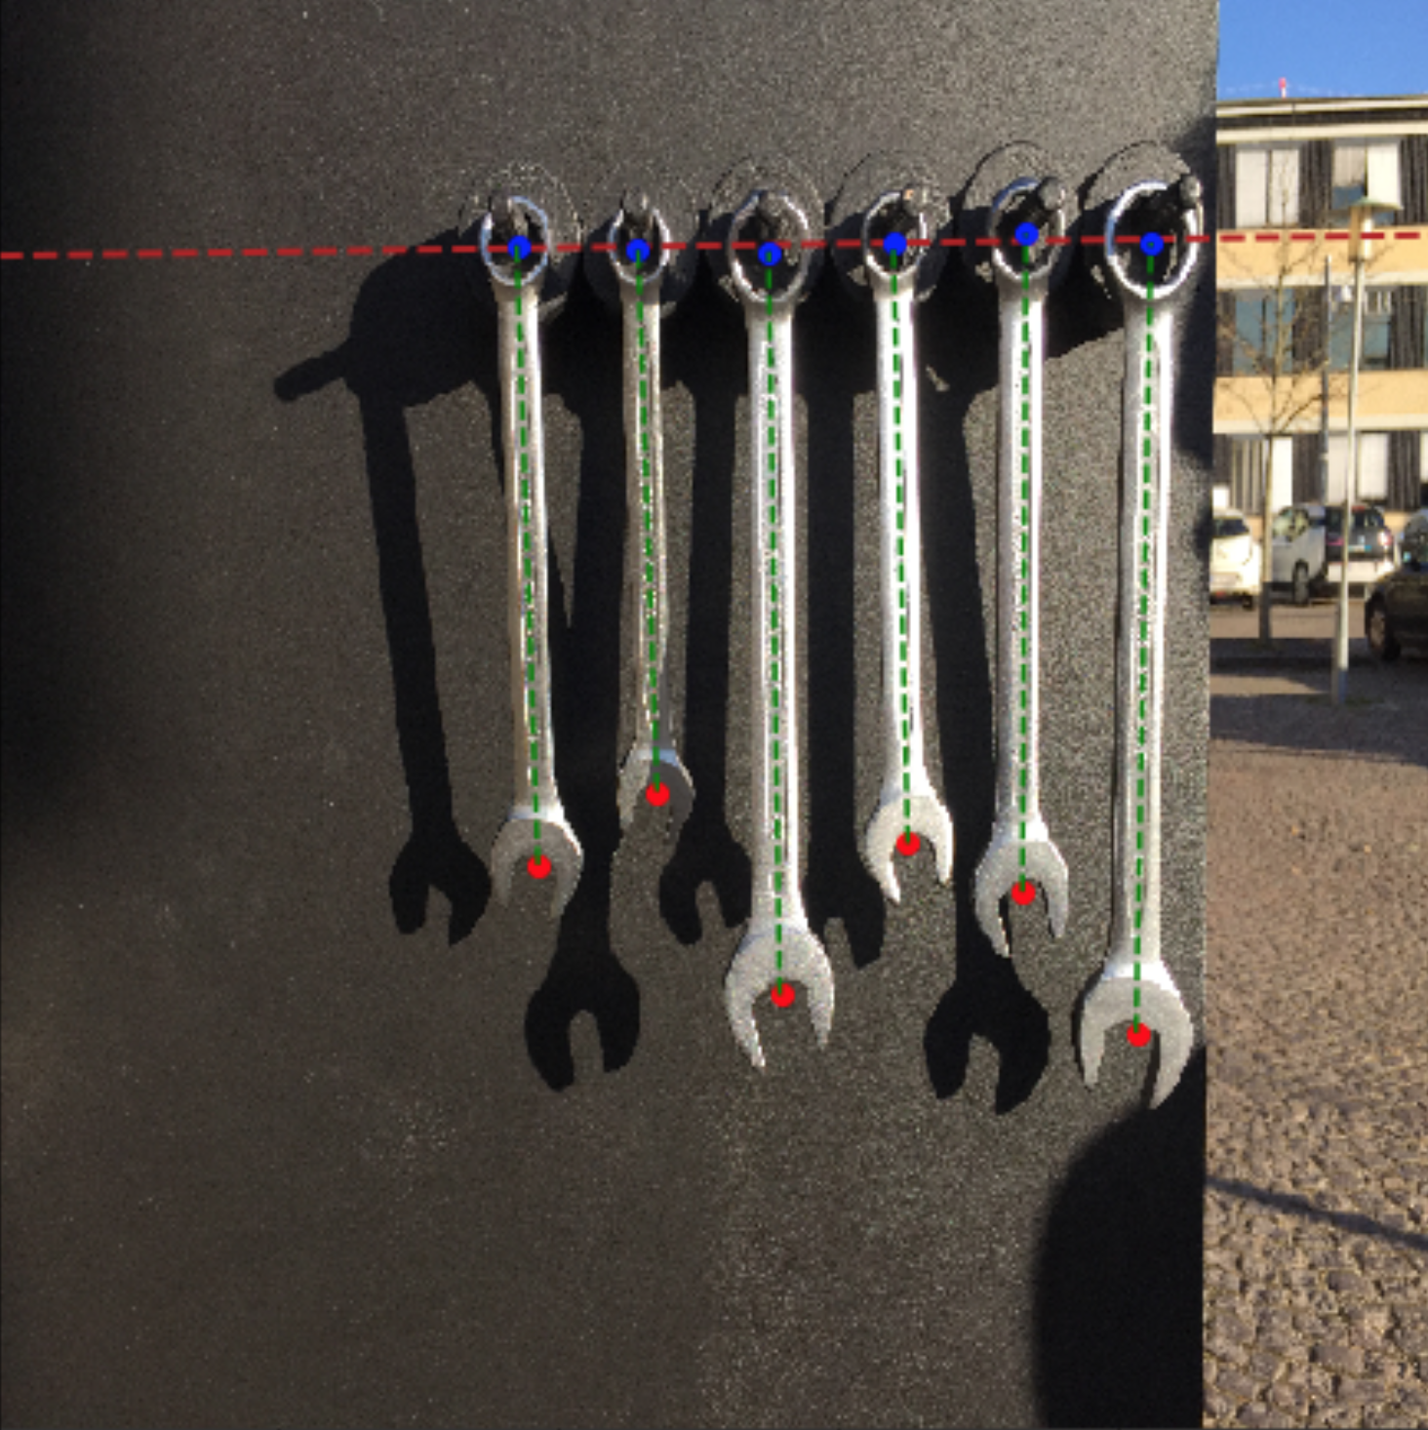
Post-processing
Notes:
BJARKE

Slide 15
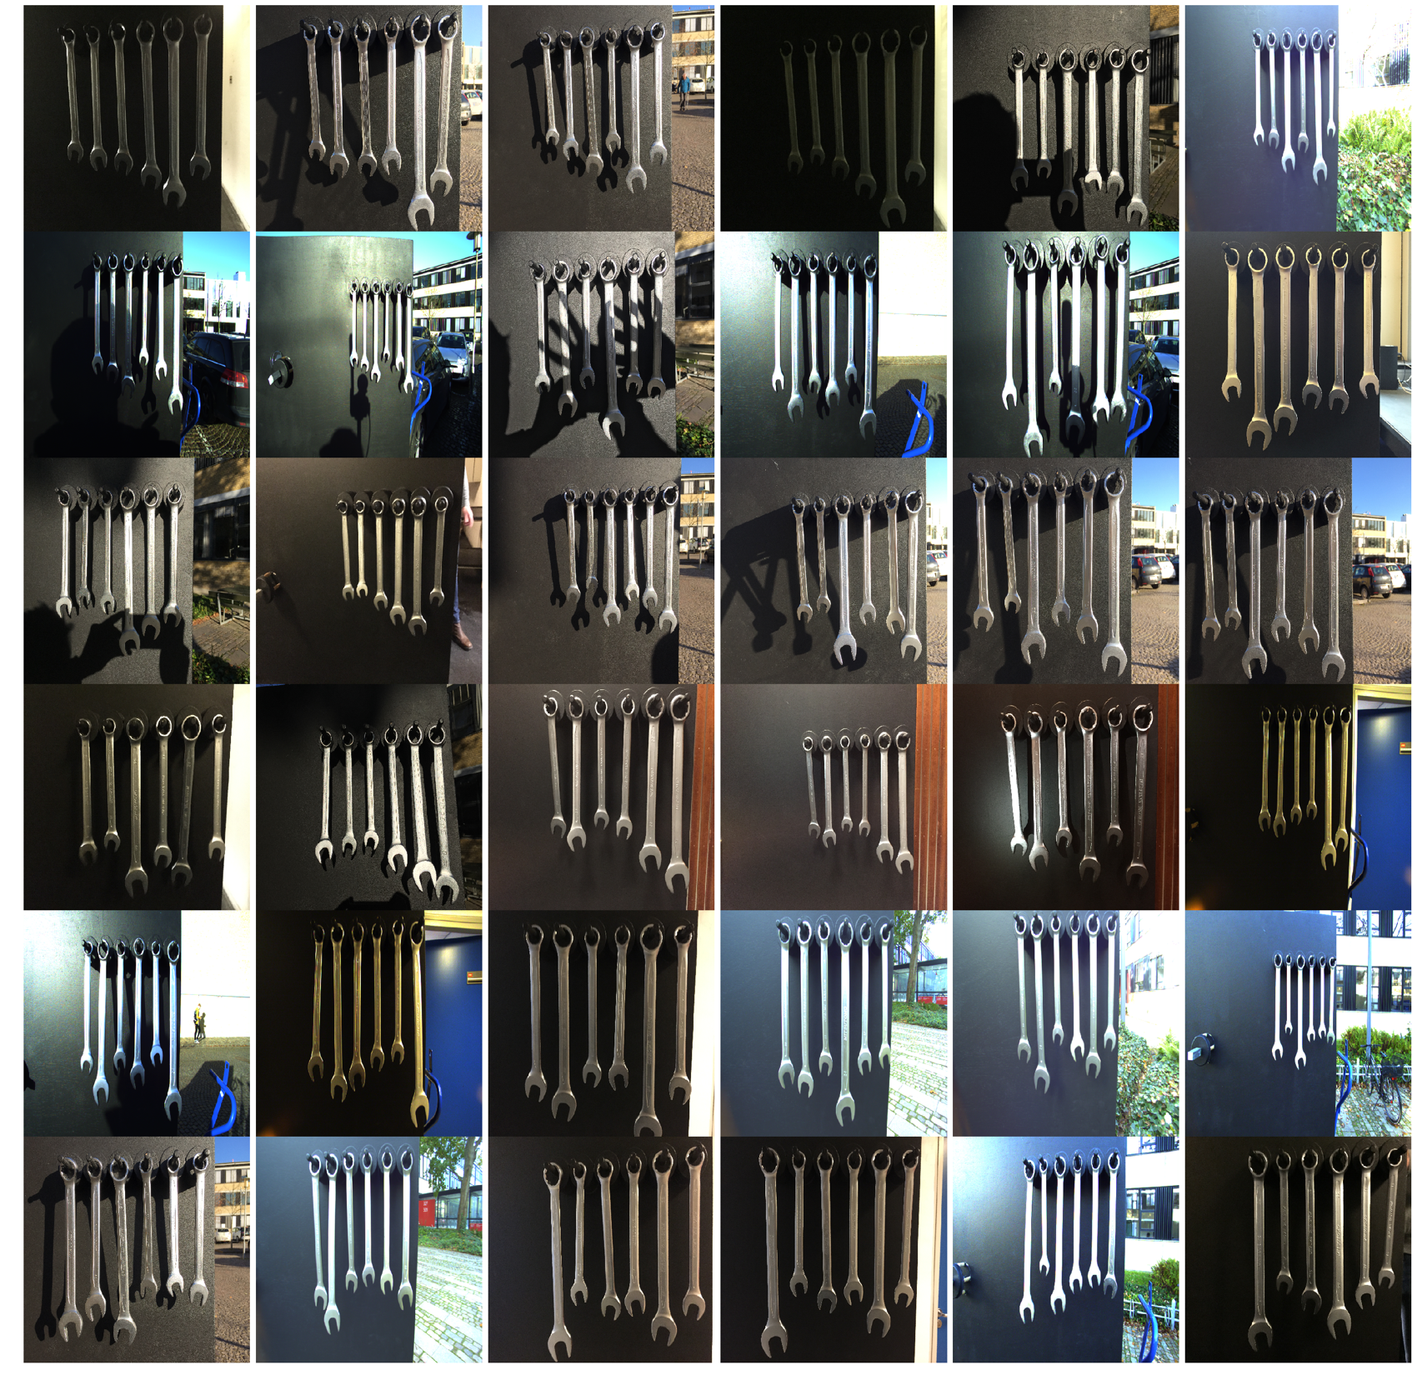
Results
Test set consisting of:
36 images
Various scenography
 | Accuracy
Locate Top/Bottom | 100%
Wrench 16 | 97.22%
Wrench 17 | 80.56%
Wrench 18 | 72.22%
Wrench 19 | 86.11%
Wrench 22 | 94.44%
Wrench 24 | 97.22%
Total | 87.96%
Notes:
SERVET
- Original solution was 1 minute and 30 seconds to find the correct wrench.
- Our solution can identify the correct wrench in approximatly 3 seconds on a GPU.

Slide 16
Future Work
No rotation/skew in real world implementation → better accuracy
More intelligent post-processing to compensate for variations in images
Test of smaller (faster) models, e.g. SSD Mobilenet [8], YOLO [9] or sparser version of Faster R-CNN.
[8] - https://arxiv.org/pdf/1512.02325.pdf
[9] - https://arxiv.org/pdf/1506.02640.pdf
Notes:
JESPER

